Slide 1
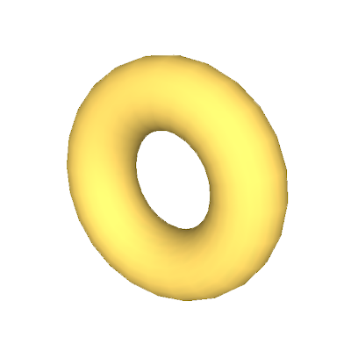
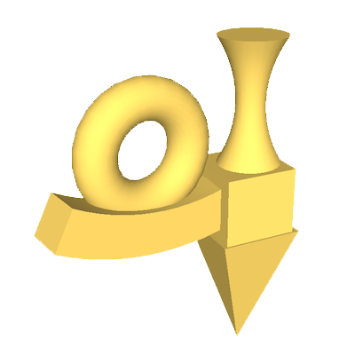
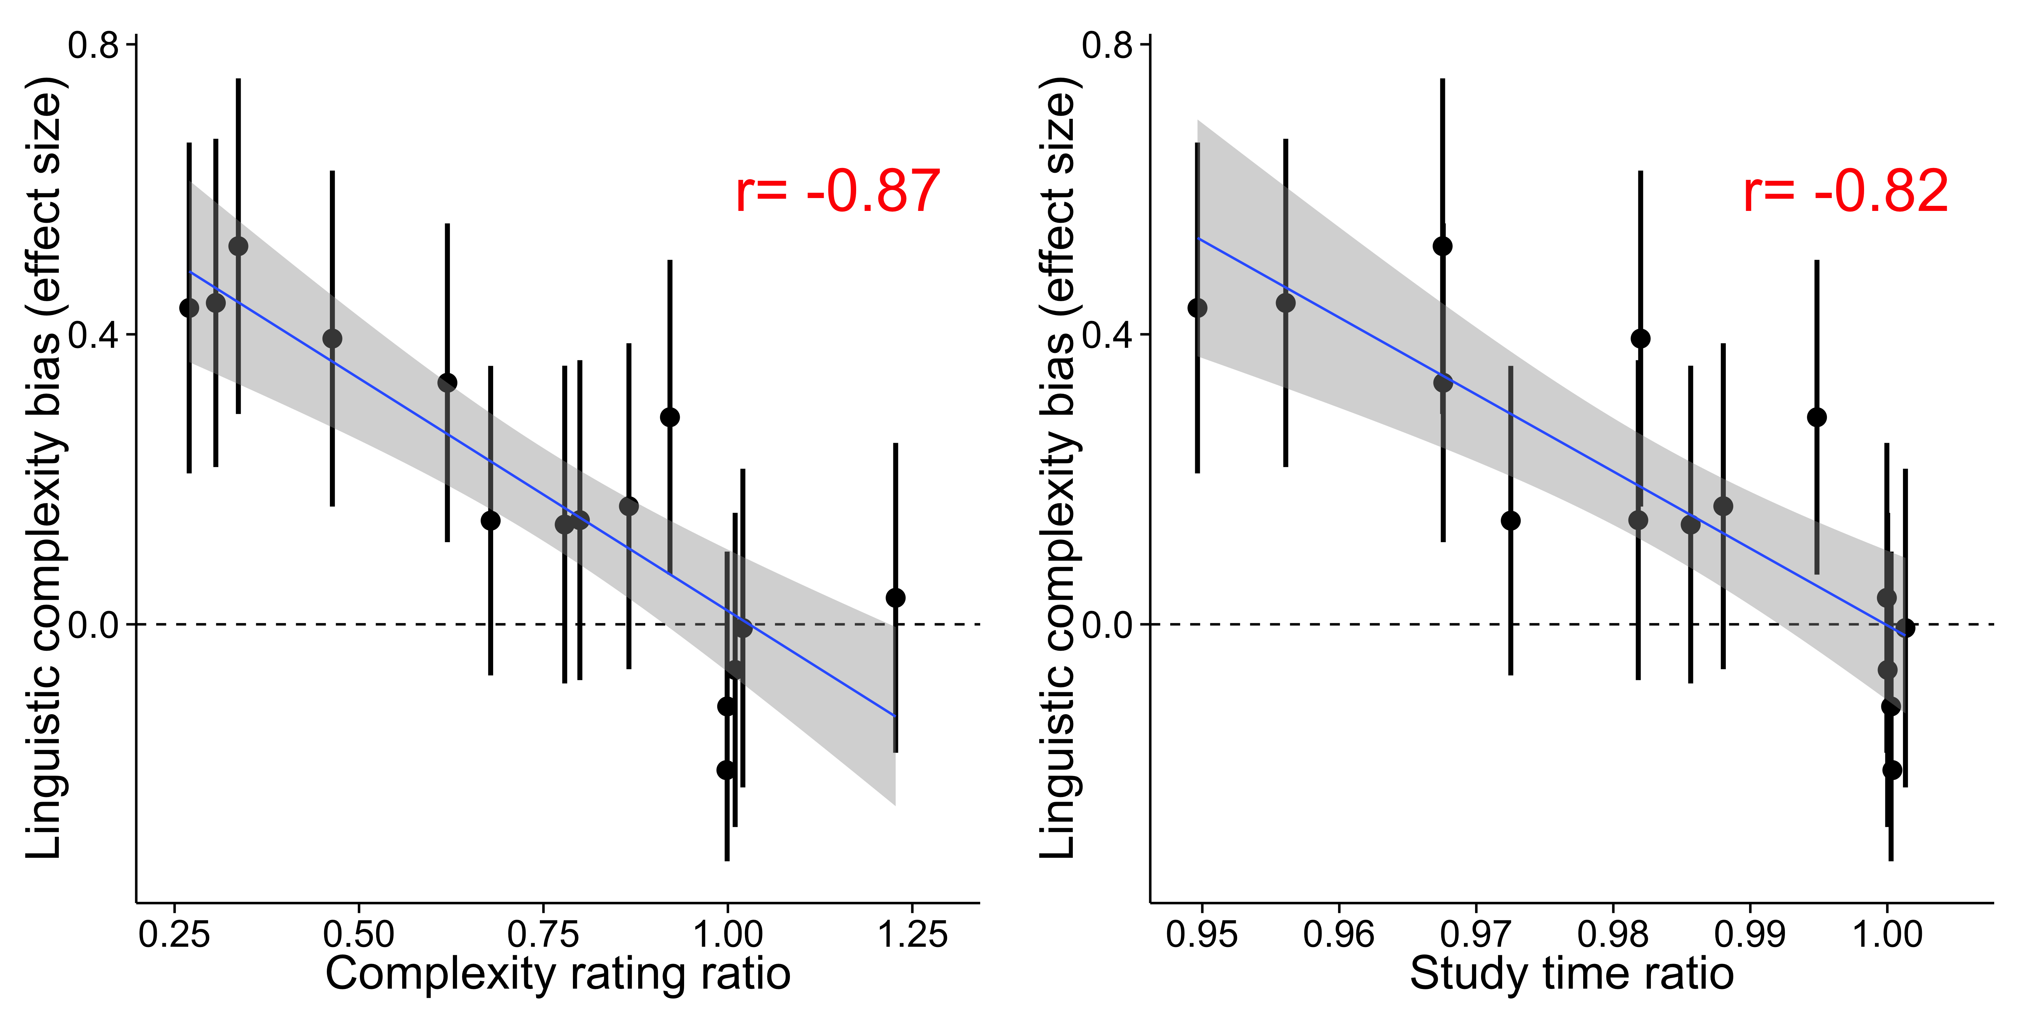
a
Imagine you just heard someone say fepolopus. Which object do you think fepolopus refers to?
b
c
d

Slide 2
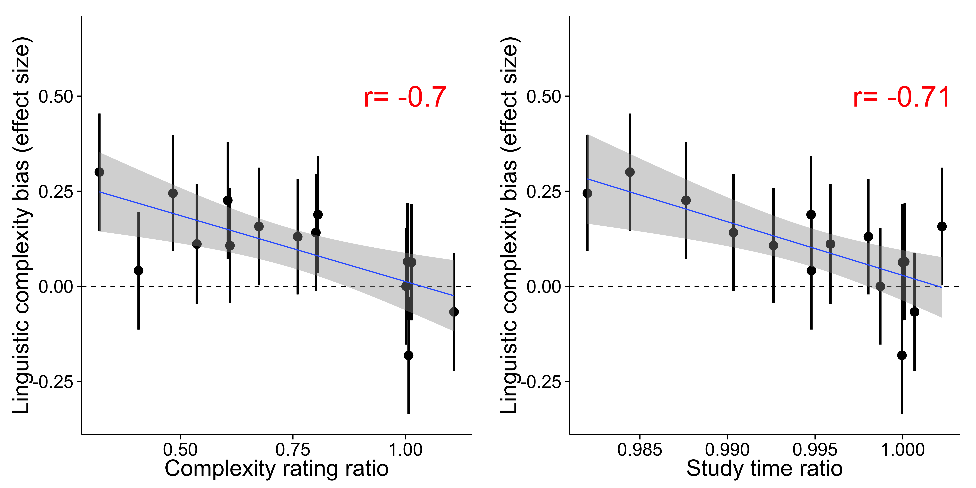
a
b
c
Notes:
linguistic complexity preference (effect size)

